Slide 1
LG Auto-dosing Washer – CX Proposal
Amazon Confidential

Slide 2
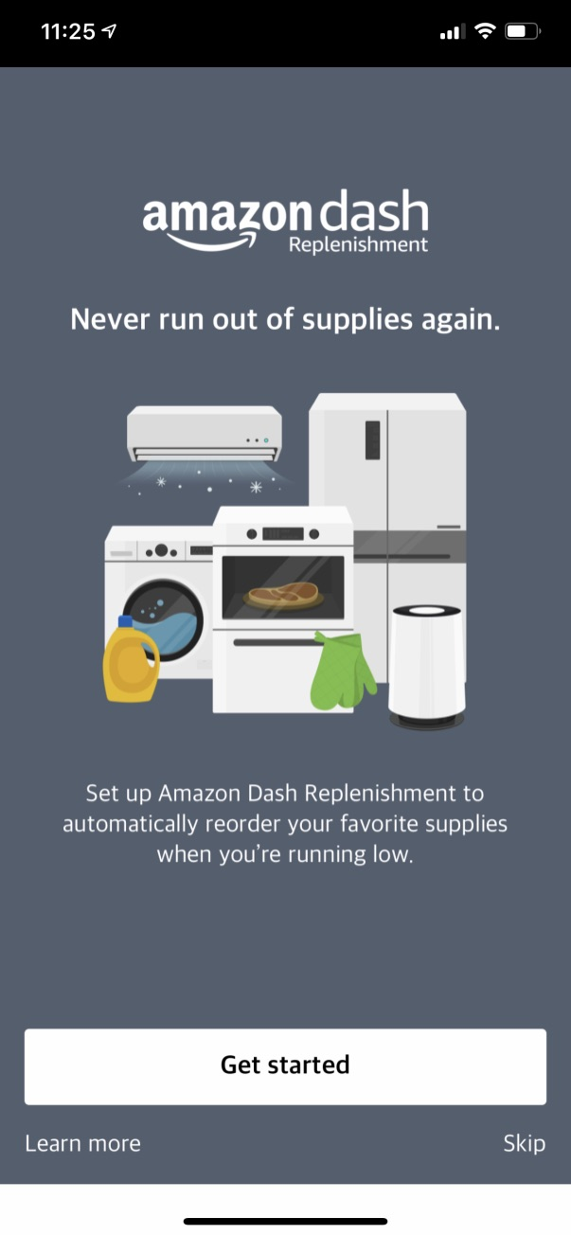
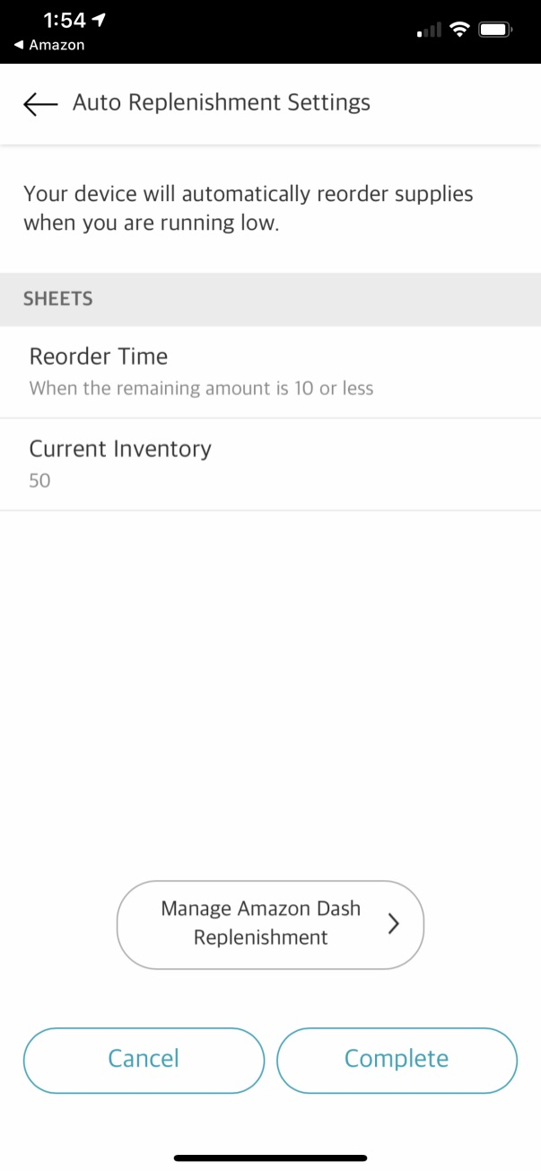
LG Current DRS CX
Standard DRS flow, already supported in the LG’s app
Device is Connected
DRS Configuration Flow
Note: Above CX snapshots are for reference purpose only. These snapshots do not reflect the interface which will be made available for end-customers

Slide 3
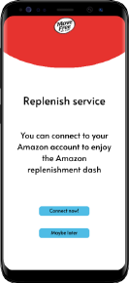
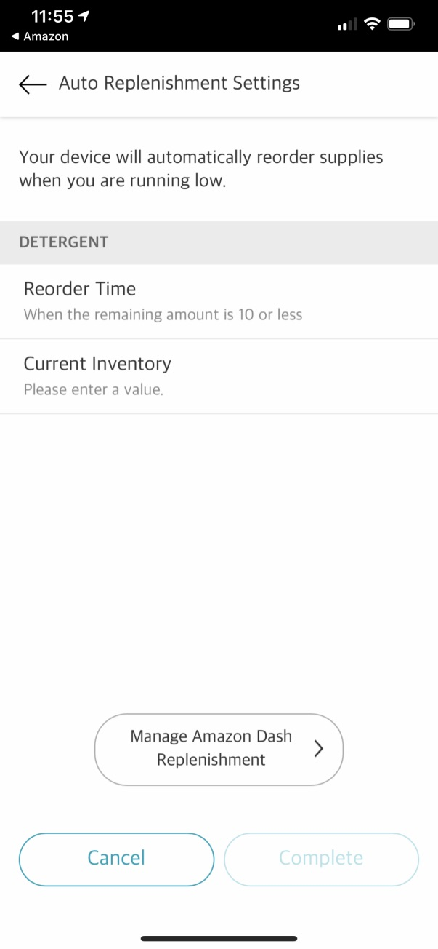
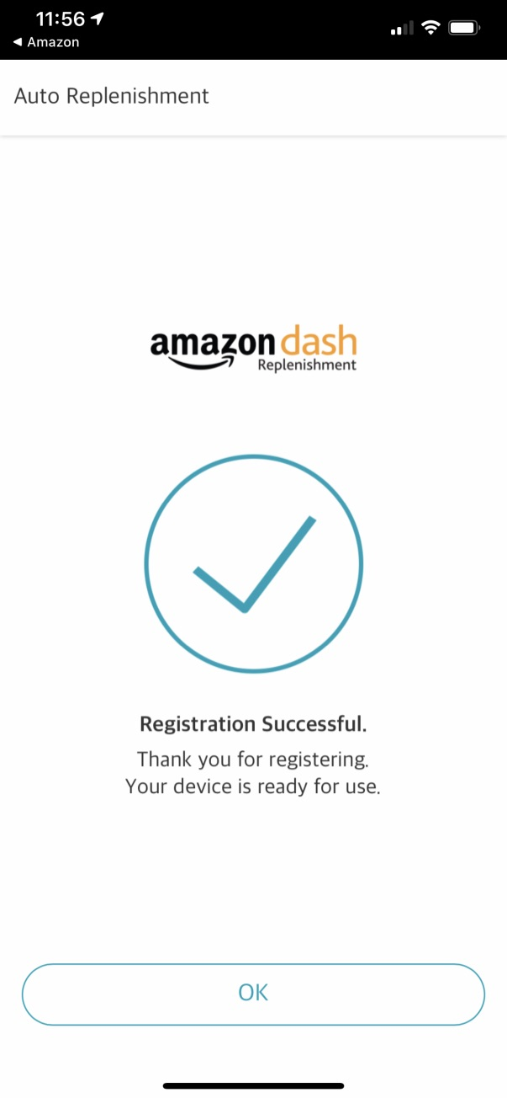
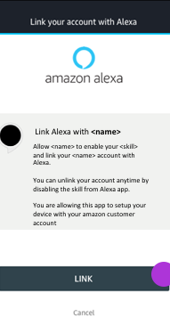
LG CX Proposal - Skill enablement and DRS
App-to-app account linking: Skill enablement, needed only once
Standard DRS flow, already supported in the LG’s app
Device is Connected
ASIN Selection Flow - Amazon
Alexa app or LWA
Teaser page: Managed by LG
ASIN selection flow: Managed by Amazon
Inventory and successful pages: Managed by LG
Note: Above CX snapshots are for reference purpose only. These snapshots do not reflect the interface which will be made available for end-customers

Slide 4
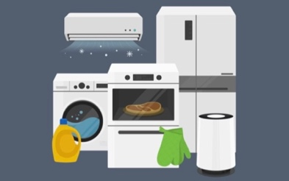
LG CX Proposal - Skill enablement and DART
App-to-app account linking: Skill enablement, needed only once
Call the extensibility URL to show the setup experience in ThinQ app
Congratulations, Dash Replenishment setup is now complete!
We’ll send you an order confirmation email when your device reorders supplies for you.
You can view or change your reorder information at any time in the Supply section of your device’s Settings.
Device is Connected
Supplies when you need it
Alexa knows when you’re running low on supplies and can automatically place an order through Amazon Dash Replenishment.
ASIN Selection Flow
Finish
Alexa app or LWA
Complete flow from the teaser page to inventory configuration is managed by Amazon, all LG has to do is call the extensibility URL
Note: Above CX snapshots are for reference purpose only. These snapshots do not reflect the interface which will be made available for end-customers

Slide 5
LG’s Current CX Flow and Proposal
Connect device
Connect device
Connect device
Teaser Page
Is skill enabled?
Is skill enabled?
Yes
Yes
No
No
ASIN Selection flow
Skill enablement: App-to-app account linking
Skill enablement: App-to-app account linking
Configure household inventory
New steps
Call extensibility URL: DART setup as webview
Teaser page
Setup complete
DRS Setup flow
Teaser Page
ASIN Selection flow
Current stage: DRS
Configure household inventory
Inventory Configuration
New steps
Pages designed by LG
Setup complete
Setup complete
Pages managed by Amazon, shown in the LG app as webpages
Phase 1: DRS w/ Skill enablement
Phase 2: DART w/ Skill enablement

Slide 6
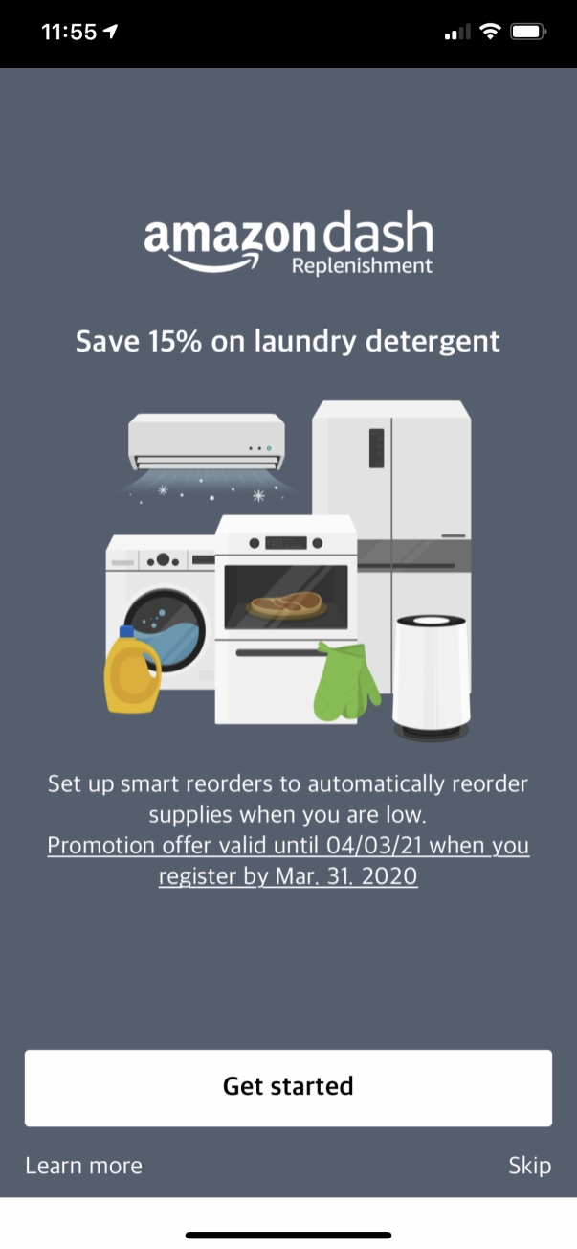
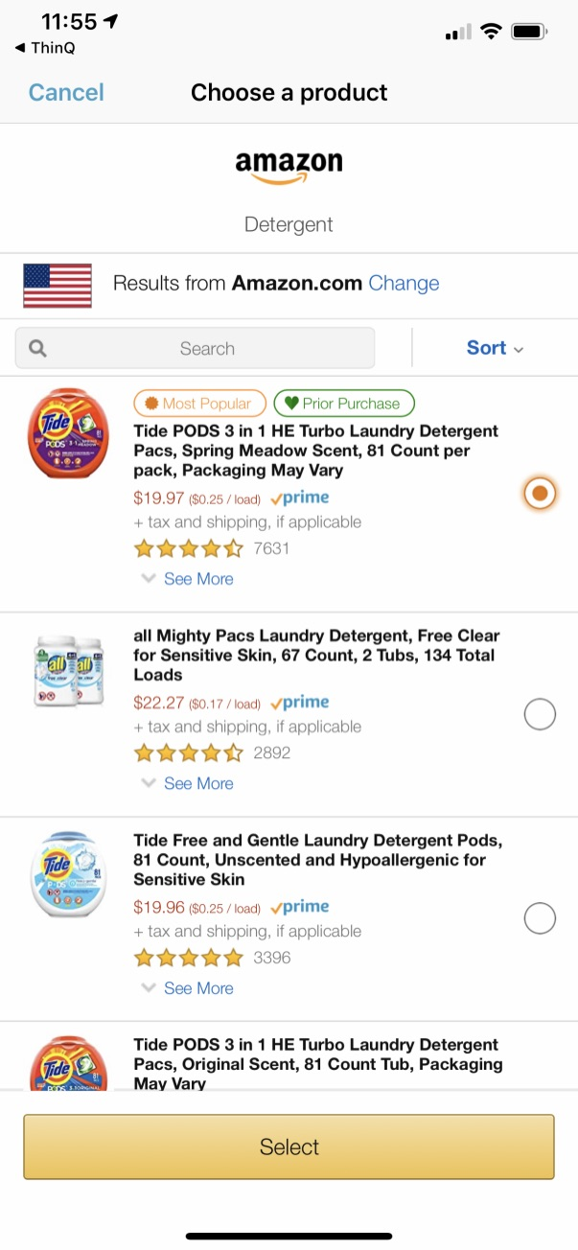
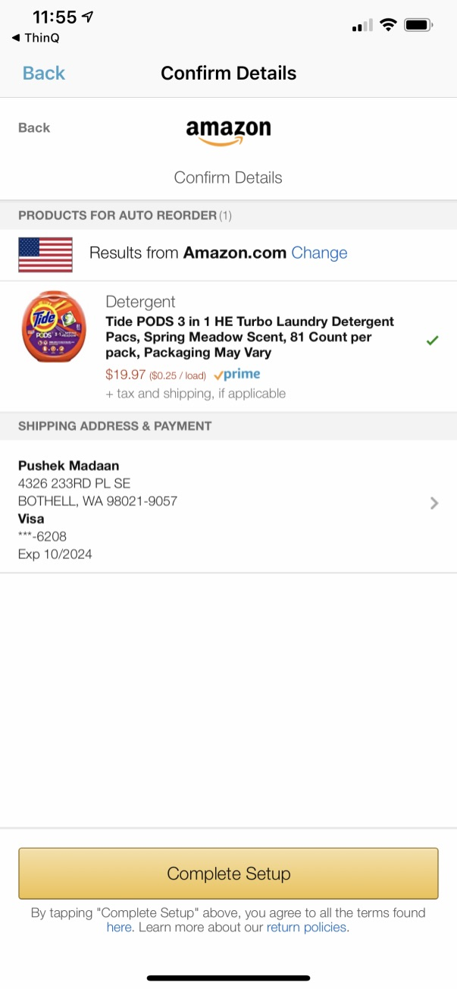
DRS Configuration Flow

Slide 7
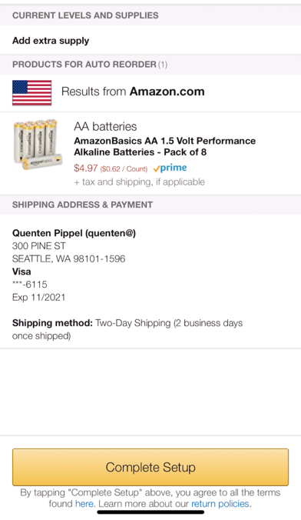

DART Registration: DART Configuration Flow (reference snapshots)
Toilet Paper Roll
Toilet Paper Roll
Congratulations, Dash Replenishment setup is now complete!
We’ll send you an order confirmation email when your device reorders supplies for you.
You can view or change your reorder information at any time in the Supply section of your device’s Settings.
Supplies when you need it
Alexa knows when you’re running low on supplies and can automatically place an order through Amazon Dash Replenishment.
Vitamins
Currently Remaining
Finish
Note: Above CX snapshots are for reference purpose only. These snapshots do not reflect the interface which will be made available for end-customers

Slide 8








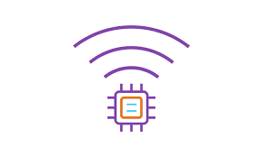
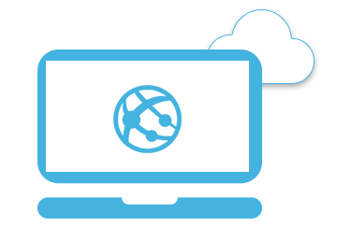
Demo Architecture
Partner’s Backend Infrastructure
PSU Interface
Asynchronous Updates
CloudWatch
Smart Home Skill
Sync Updates
DynamoDB
Synchronous Updates
API Gateway
Manage Things
Account Linking
AWS IoT
Cognito User base
Web Interface
Simulated device
Webapp

